Slide 1
Propertius – Elegiac Love Poet
11/27/17

Slide 2
Sextus Propertius
Very little is known of his life outside of his poetry
Born around 50 BC; died around 15 BC
Grew up in Umbria, town of Assisi is allegedly his birthplace

Slide 3
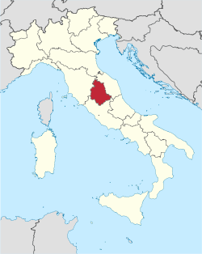
https://upload.wikimedia.org/wikipedia/commons/thumb/8/80/Umbria_in_Italy.svg/250px-Umbria_in_Italy.svg.png

Slide 4
Sextus Propertius
Very little is known of his life outside of his poetry
Born around 50 BC; died around 15 BC
Grew up in Umbria, town of Assisi is allegedly his birthplace
Family was thought to be wealthy – owned a farm; his mother desired for him to have a career in public service; his poetry shows he was educated; he lived on the Esquiline Hill in Rome

Slide 5
Sextus Propertius
Published his first book of elegies in 25 BC; Maecenas took notice and began to sponsor him
Contemporary of Vergil and Ovid
Very emotional like Catullus and frequently used allusion
Wrote many of his poems about a woman he called Cynthia, whose real name was Hostia
She was depicted as “unfaithful, vain, and capricious.”
Cynthia was an epithet of Diana...
Notes:
Why Diana? Goddess of the moon (who looks down upon lovers and their activities), also connected to Hecate, goddess of witchcraft.

Slide 6
Latin Love Elegy
Shared many characteristics with Catullus’ poetry
All love elegies were written in the Elegiac Couplet meter
Celebrated love, poetry, and otium against military and political success
Several recurring themes which you have seen in Catullus…
Notes:
Goes against traditional Roman virtues and conventions with emphasis on leisure.

Slide 7
Latin Love Elegy
Militia amoris – love is a battlefield; the poet a soldier
Servitium amoris – male lover becomes a slave to his woman, the domina
Traditional gender roles are reversed: in elegy the man (poet) is faithful and the woman is promiscuous and cheating
Miser amator – Poems where the lover is miserable usually outnumber ones when he is happy

Slide 8
Bibliography
Colakis, Marianthe. Lectiones Memorabiles Volume 1: Selections from Catullus, Cicero, Livy, Ovid, Propertius, Tibullus, and Vergil. Mundelein, Ill.: Bolchazy-Carducci, 2015.

