Slide 1
Publius Vergilius Maro
70-19 BC

Slide 2
Publius Vergilius Maro
Born near Mantua in 70 BC
Little is known of his personal life
Came from modest background but was well educated
Wrote three major works of Latin Literature: The Eclogues, Georgics, and Aeneid
The Eclogues were in the style of “pastoral poetry”; published in 39 or 38 BC
The Georgics (29 BC) was a didactic work for farmers
Notes:
Father was farmer; Vergil was educated in Mediolanum (Milan), Rome, and Naples
More on the Eclogues – based on Greek models and glorified and idealized the lifestyle of shepherds; the simple life
More on the Georgics – how to deal with plants, animals, and especially bees; also glorified life of a farmer

Slide 3
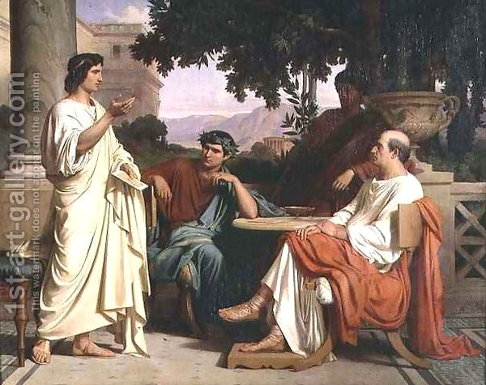
Maecenas
Patron of Vergil and other poets
Served as an aide to the emperor Augustus
Used poetry to benefit Rome
Patriotic tones are found in works of Vergil and Horace

Slide 4
The Aeneid
Arma virumque cano…
Written from 29-19 BC
Vergil died with the work unfinished
Dactylic Hexameter
Seen by many as Rome’s “national poem”
Great amount of Roman propaganda – it was commissioned by Augustus
Books I-VI reflect the Odyssey
Books VII-XII reflect the Iliad
Notes:
Vergil intended to spend 3 whole years in Greece revising the Aeneid but he fell ill after he got there and decided to come back home. Died in Brundisium and was buried in Naples. Ordered the book to be burned, obviously it wasn’t!
Propaganda appears in Vergil’s praise for the Julian family who is descended from the hero Aeneas. He appears an an instrument of the gods to bring Rome to greater glory. Also used the book for Rome to adopt Trojan practices and customs. Went along with Augustus’ plan for Rome to go back to the “good old days” of morals and customs. Wants Rome to return to the alleged golden age and renew faith in the gods.

Slide 5
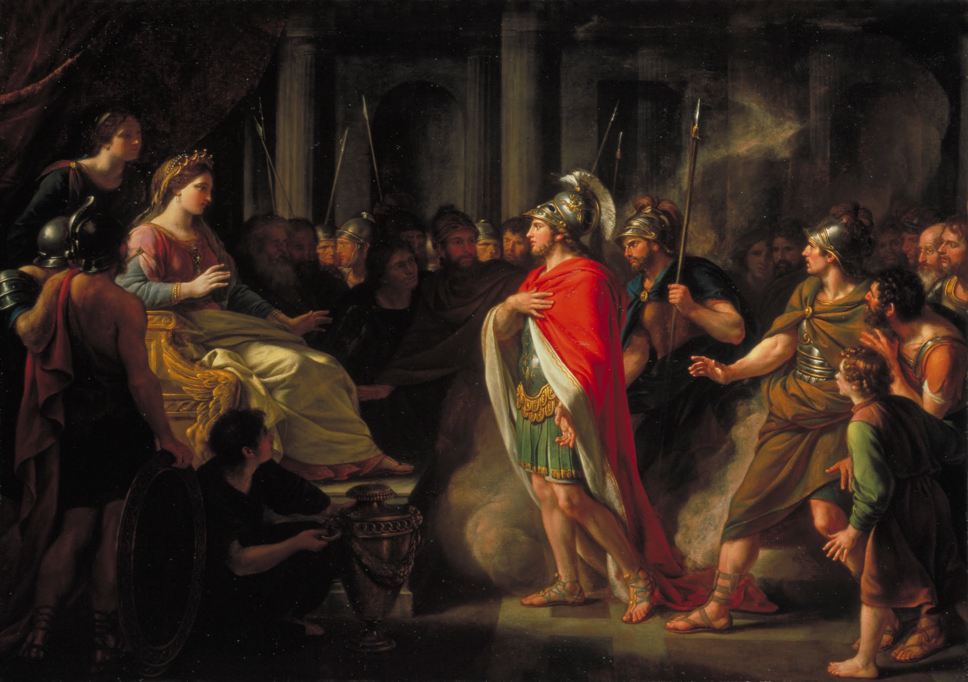
Books I-VI
Book 1: A storm drives the Trojans to Carthage; Aeneas meets Dido
Book 2: Sack of Troy
Book 3: The Trojans’ journey to Carthage
Book 4: Aeneas leaves Carthage
Book 5: Death of Anchises
Book 6: Arrival in Italy; trip to the underworld

Slide 6
Books VII-XII
Book 7: Aeneas is given to Lavinia, daughter of the King of the Latins; her fiance Turnus prepare to fight the Trojans
Book 8: Aeneas allies with King Evander of Arcadia
Book 9: Death of two noble Trojans
Book 10: Death of Evander’s son Pallas
Book 11: Aeneas and Turnus decide to duel
Book 12: Aeneas kills Turnus, takes over Latium

Slide 7
Photo Credits
http://www.1st-art-gallery.com/thumbnail/234633/1/Horace-Virgil-And-Varius-At-The-House-Of-Maecenas.jpg
http://upload.wikimedia.org/wikipedia/commons/8/82/Sir_Nathaniel_Dance-Holland_-_The_Meeting_of_Dido_and_Aeneas_-_Google_Art_Project.jpg

