Slide 1
Roman Views of Foreigners
Gauls and More!
11/1/16
Notes:
Cicero’s

Slide 2
First World vs. Third World
Even in the Roman world, there was a divide between cultures which seemed to be civilized and those which were not.
Basically, it came down to the Greeks and everyone else
Notes:
Provide context of how Romans dealt with people whom they conquered. They let them do whatever they wanted, as long as they paid homage to the Roman gods. They came to include many Roman gods in their pantheons. It worked the other way around too! (Isis, Mithras).
“This is Rome, a state formed by the gathering of nations.” -Cicero

Slide 3
Views of the Greeks
And What About all Those Greeks?
That race most acceptable now to our wealthy Romans,
That race I principally wish to flee, I’ll swiftly reveal,
And without embarrassment. My friends, I can’t stand
A Rome full of Greeks, yet few of the dregs are Greek!...
Quick witted, of shamelessly audacity, ready of speech, more lip than Isaeus, the rhetorician. Just say what you want them to be. They’ll bring you, in one person, whatever you need: the teacher of languages, orator, painter, geometer, trainer, augur, rope-dancer, physician, magician, they know it all, your hungry Greeks: tell them to buzz off to heaven, they’ll go.
Juvenal, Satires
Notes:
Romans tended to disdain the Greeks, but clearly they had valuable qualities.

Slide 4
Views of the Greeks
Seeking to prejudice his son against Greek culture, he indulges in an utterance all too rash for his years, declaring, in the tone of a prophet or a seer, that Rome would lose her empire when she had become infected with Greek letters. But time has certainly shown the emptiness of this ill-boding speech of his, for while the city was at the zenith of its empire, she made every form of Greek learning and culture her own.
Plutarch, Life of Cato

Slide 5
Rome’s Real Opinion of Greece?
Graecia capta ferum victorem cepit et artes intulit agresti Latio. (Horace, Epistles)
Conquered Greece took captive her savage conqueror and brought her arts into rustic Latium.
Rome adopted principles of Grecian art, rhetoric, architecture, philosophy, and (of course) religion.
Notes:
Greek culture came to heavily influence Rome. It’s safe to say the Romans admired the Greeks (slaves as tutors, etc.).

Slide 6
Views of Gaul
The Gauls are terrifying in aspect and their voices are deep and altogether harsh; when they meet together they converse with few words and in riddles, hinting darkly at things for the most part and using one word when they mean another; and they like to talk in superlatives, to the end that they may extol themselves and depreciate all other men. They are also boasters and threateners and are fond of pompous language, and yet they have sharp wits and are not without cleverness at learning.
Diodorus Siculus

Slide 7
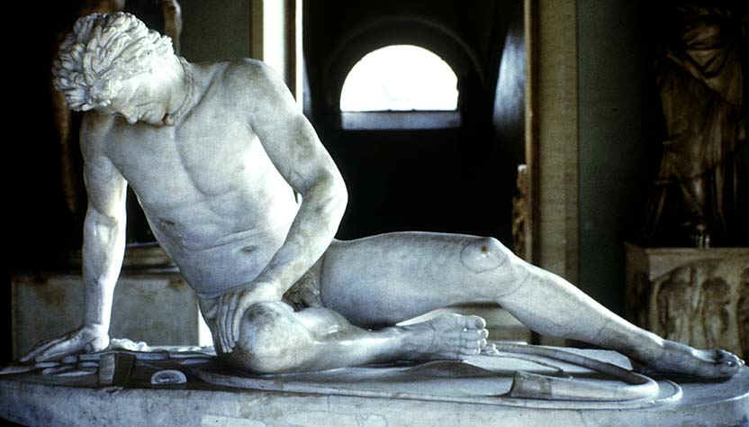
Notes:
http://classes.maxwell.syr.edu/his301-001/Dying%201.jpg

Slide 8
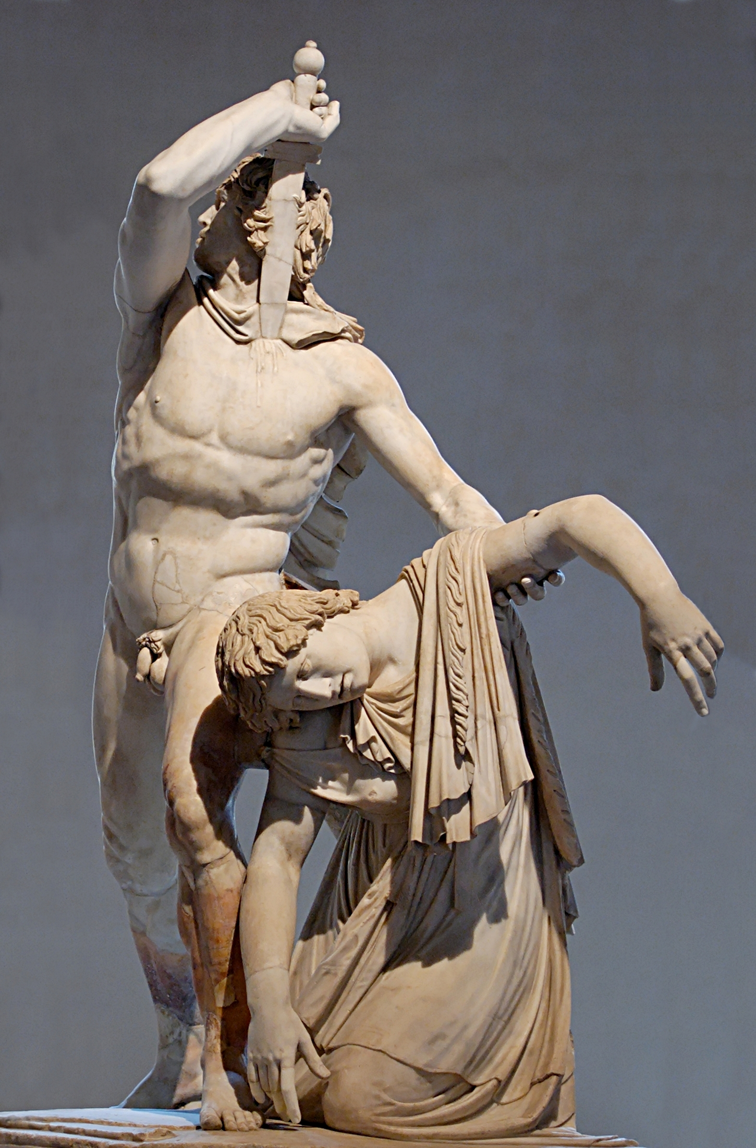
Notes:
http://www.thehistoryblog.com/wp-content/uploads/2013/12/Ludovisi_Gaul-3.jpg

Slide 9
View of Britons
They dwell in tents, naked and unshod, possess their women in common, and in common rear all the offspring. Their form of rule is democratic for the most part, and they are very fond of plundering; consequently they choose their boldest men as rulers…They can endure hunger and cold and any kind of hardship; for they plunge into the swamps and exist there for many days with only their heads above water, and in the forests they support themselves upon bark and roots, and for all emergencies they prepare a certain kind of food, the eating of a small portion of which, the size of a bean, prevents them from feeling either hunger or thirst.
Cassius Dio

Slide 10
Views on Syrians
For the Syrian Orontes has long since polluted the Tiber, bringing its language and customs, pipes and harp-strings, and even their native timbrels are dragged along too, and the girls forced to offer themselves in the Circus.
Juvenal, Satires
…Jews and Syrian nations, themselves born for slavery.
Cicero

Slide 11
Views on..???
On many of the mountains again, there is a tribe of men who have the heads of dogs, and clothe themselves with the skins of wild beasts. Instead of speaking, they bark; and, furnished with claws, they live by hunting and catching birds.
…another race of men, who are known as Monocoli, who have only one leg, but are able to leap with surprising agility. The same people are also called Sciapodæ,: because they are in the habit of lying on their backs, during the time of the extreme heat, and protect themselves from the sun by the shade of their feet. These people, he says, dwell not very far from the Troglodytæ; to the west of whom again there is a tribe who are without necks, and have eyes in their shoulders.
Notes:
By Pliny the Younger, Natural Histories

