Slide 1
Gaius Julius Caesar
De Bello Gallico

Slide 2
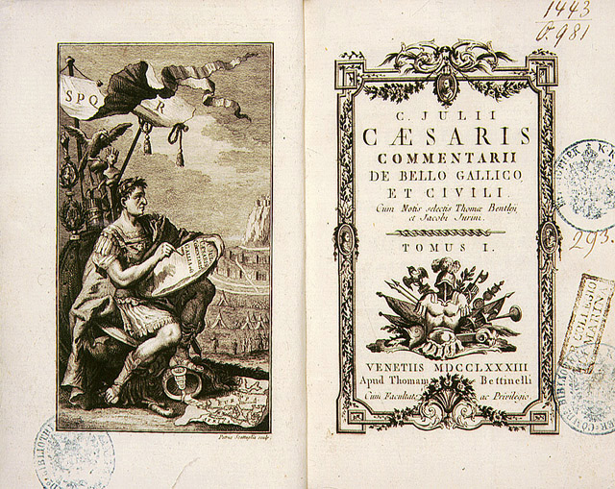
De Bello Gallico
Divided into 8 books
This work was actually written by Julius Caesar himself (except for the final book – that was written after his death)
Describes his military campaigns in Gaul during the years 58-52 BC
“Gallia est omnis divisa in partes tres…”

Slide 3
Purpose of De Bello Gallico
Many of Caesar’s enemies were wary of the power he was gaining from his military success in Gaul and that he would abuse his authority
Realizing this, Caesar knew that he had to connect with the plebeians – the lower class
He wrote this work in simple and direct prose to achieve this goal
Other stylistic traits include writing in the third person and writing in the historical present
Notes:
He is trying to justify his presence in Gaul which was technically illegal since being governor/pro-consul was supposed to be a one year thing. He was afraid that they would prosecute him when he came back from Rome and strip him of all of his power. He wanted to the plebeians to think that he was simply doing all of this to increase Rome’s glory throughout the world. Then he would be untouchable because the people would flip if the Senate tried to to anything to Caesar.
Simple prose allowed anyone to read and he did a great job of keeping the action moving.

Slide 4
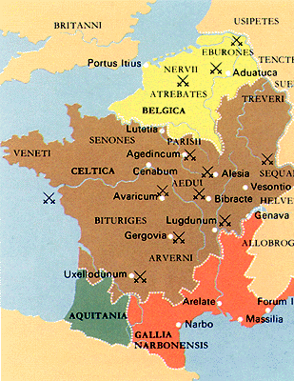

Slide 5
Our story – Book V
In the setting of our story, we are in the year 54 BC when the Gauls revolt while Caesar is away in Rome
The Roman camp is being sieged and the legion has to fend for itself
What do you think the purpose of our passage is?
Vorenus and Pullo are two rivals looking to become primus pilus (“first spear,” the top ranking centurion in a legion)
Notes:
Purpose – Display of Roman valor and fortitude in the face of adversity; strength of Roman soldiers who are helping civilize the world; lesson of how each Roman is able to contribute

Slide 6
Organization of a Legion
The major key to a legion’s success is organization
Each legion consists of about 4,800 men
These men are divided into 10 cohorts
Each cohort consists of 6 centuries of about 80 men
Each century is led by a centurion
Visual…
Notes:
All of the top centurions were in the first cohort.

Slide 8
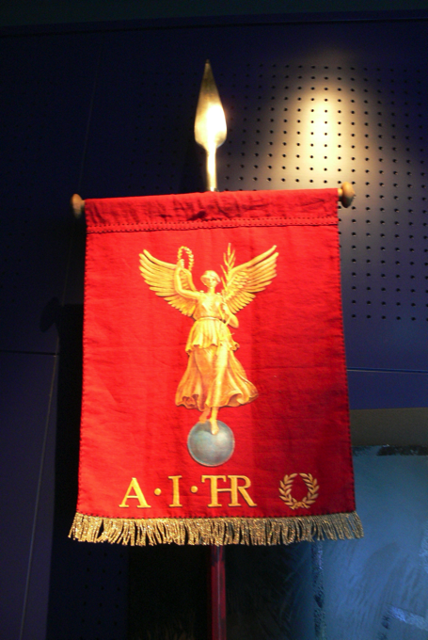
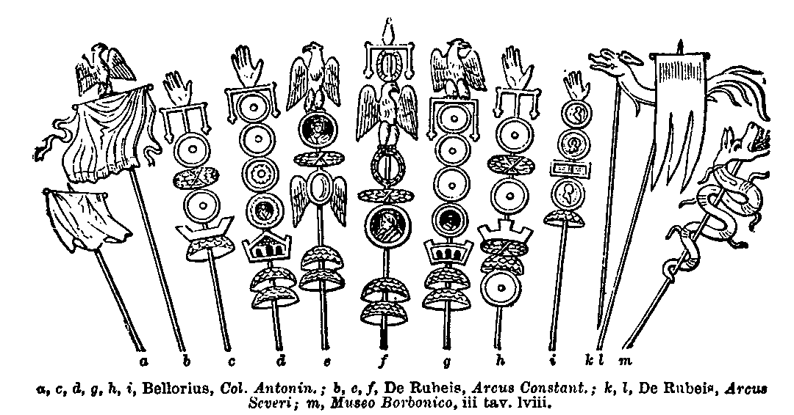
Other Legion Facts
Each legion was led into battle by a standard and silver eagle; if an army lost its standard in battle it was often dissolved
Notes:
Cite Crassus’ disaster with the Parthians as an example of a dissolution.
Other jobs that didn’t involve fighting – horn players, man who carried image of the emperor, others who had specialized skills (doctors, hunters, engineers, carpenters, etc.)

Slide 9
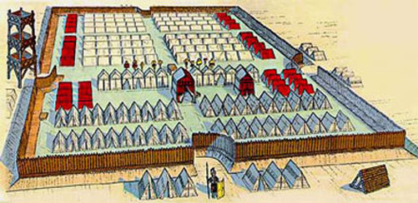
Other Legion Facts
In addition to carrying weapons, Roman soldiers also carried all the supplies needed to set up camp each night
Each soldier had specific materials for a specific job
Legions stayed in some camps for so long they ended up being permanent settlements (and later cities!)

